Slide 1

FINAL YEAR DESIGN PROJECT (FYDP-II) • FINAL DEFENSE
NeuroVerse
An AI-Integrated Student Mental Health & Wellness Ecosystem with Decoupled Real-Time Microservice Intelligence
Course: CSE 4800 / CSE 4889 Final Year Design Project II | Department of Computer Science & Engineering | UIU
Team: Team NeuroLink | Status: Operational Full-Stack & Machine Learning Microservice Ecosystem

Slide 2
PROJECT TEAM • 02/27
Team NeuroLink & Role Allocations
Multidisciplinary student team delivering the end-to-end full stack, machine learning & clinical flows
MS
Muhiminul Amin Shafin
ID: 011221456
• System Architecture
• Node/Express Backend
• JWT Security & RBAC
• MongoDB Management
MA
MD Annan
ID: 011222128
• ML Pipeline Engineering
• NLP Sentiment Triage
• Crisis Classification
• Model Benchmarking
WS
Wasiur Rahman Sakib
ID: 0112230747
• FastAPI Microservice
• Target Leakage Fix
• Linear Regression
• Feature Engineering
AS
Md. Asif Sarkar
ID: 0112230037
• React 18 Frontend
• Wellness Dashboard
• Telemetry Widgets
• Axios Integration
SA
Mirza Samawatun Astha
ID: 0112230887
• Peer Support Forum
• Therapist Booking
• Emergency Clinical Hub
• UX & Testing QA

Slide 3
PROBLEM STATEMENT • 03/27
The Student Mental Health Crisis
Academic pressures and severe systemic barriers prevent university students from seeking timely help
73.5%
Academic Pressure Rate
Academic Burnout
Intense competition for CGPA, relentless exam deadlines, and uncertain career prospects cause high chronic stress and burnout among university students.
68.2%
Unreported Stigma Rate
Social Stigma & Fear
Students fear being labeled or judged by peers, faculty, and family. On-campus counseling centers lack privacy, deterring students from visiting.
1:5000+
Counselor-Student Ratio
Resource Scarcity
Campus mental health services are critically understaffed, leading to multi-week waiting queues that leave students in crisis without urgent care.
4+ Apps
Disconnected Tools
Tool Fragmentation
Students must juggle separate apps for journaling, meditation, and therapy. Existing global apps ignore Bangladeshi context and require expensive subscriptions.

Slide 4
SOLUTION OVERVIEW • 04/27
The Implemented Solution: NeuroVerse Ecosystem
A unified, secure, AI-powered digital wellness ecosystem built specifically for university students
1. Proactive AI Intelligence
• Demographic Mood Regressor (1.0 to 5.0 baseline score)
• Real-Time NLP Crisis Triage (<15ms latency)
• Knowledge Graph DFS personalized learning paths
• Sleep-stress correlation alerts (r = -0.898)
2. Anonymous Peer Support
• 100% pseudonymity with zero identity leakage
• Topic feeds: Exam anxiety, burnout, loneliness
• Automated real-time content moderation
• Safe peer encouragement without faculty visibility
3. Verified Clinical Access
• Accredited psychologist profile directory
• Direct in-app appointment calendar booking
• Flexible scheduling matching class timetables
• Encrypted and isolated clinical notes
4. 24/7 Self-Help Resource Hub
• Instant one-tap national emergency helplines (999, Kaan Pete Roi)
• Interactive guided breathing & meditation timers
• Evidence-backed psycho-educational articles
• Emergency hotline modal triggered by crisis NLP

Slide 5
SYSTEM ARCHITECTURE • 08/27
System Architecture: Three-Tier Decoupled Microservice
Isolating data-intensive machine learning inference from high-concurrency web transactions
Tier 1 • Client
Presentation Layer
• React 18 & Vite SPA framework
• Tailwind CSS responsive design system
• Axios REST client with JWT cookies
• Real-time wellness telemetry widgets
Tier 2 • Primary API
Business Logic Server
• Node.js & Express.js API gateway
• JWT in HTTP-Only, SameSite cookies
• Strict Role-Based Access Control (RBAC)
• High-concurrency async request pipeline
Tier 3 • ML Engine
FastAPI Microservice
• Python 3.10 & Uvicorn ASGI workers
• Scikit-Learn (Linear & Logistic Reg)
• TF-IDF n-gram vectorization
• NetworkX Knowledge Graph DFS traversal
Tier 4 • Persistence
MongoDB Atlas Cloud
• MongoDB Atlas (v7.0) cloud cluster
• Mongoose ODM schema enforcement
• Indexed query optimization (<15ms)
• Automated point-in-time backups

Slide 6
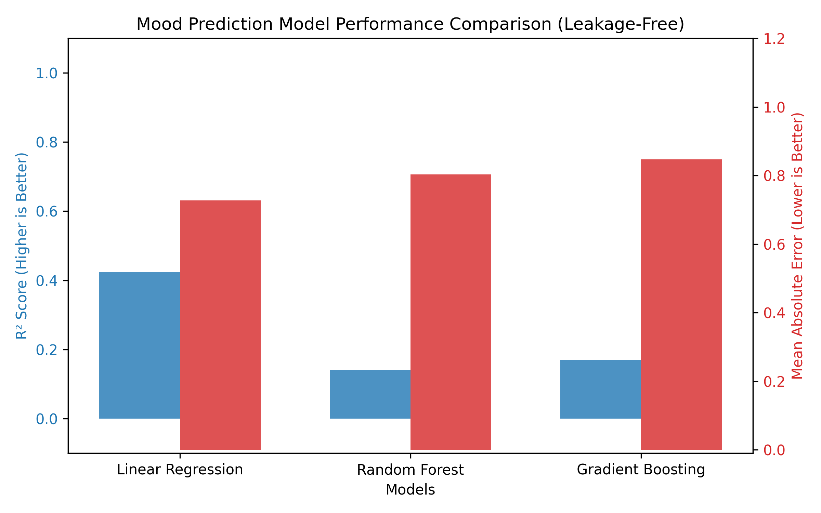
EMPIRICAL RESULTS • 13/27
Experimental Results: Demographic Mood Regression
Benchmarking regression architectures on student wellness prediction under 5-Fold Cross Validation
Model Benchmark Comparison (Holdout Set):
• Linear Regression (Selected): R² = 0.423 | MAE = 0.727
• Gradient Boosting Regressor: R² = 0.169 | MAE = 0.847
• Random Forest Regressor: R² = 0.142 | MAE = 0.803
Key Technical Discussion:
• Why Linear Regression Outperformed Ensembles: Demographic predictors (academic progression, marital status) exhibit linear macro trends. Complex tree ensembles suffered from variance overfitting on the limited demographic sample size.
• Operational Significance: Linear regression achieves stable baseline predictions with an MAE of 0.727 on a 5.0 scale without overfitting.

Slide 7
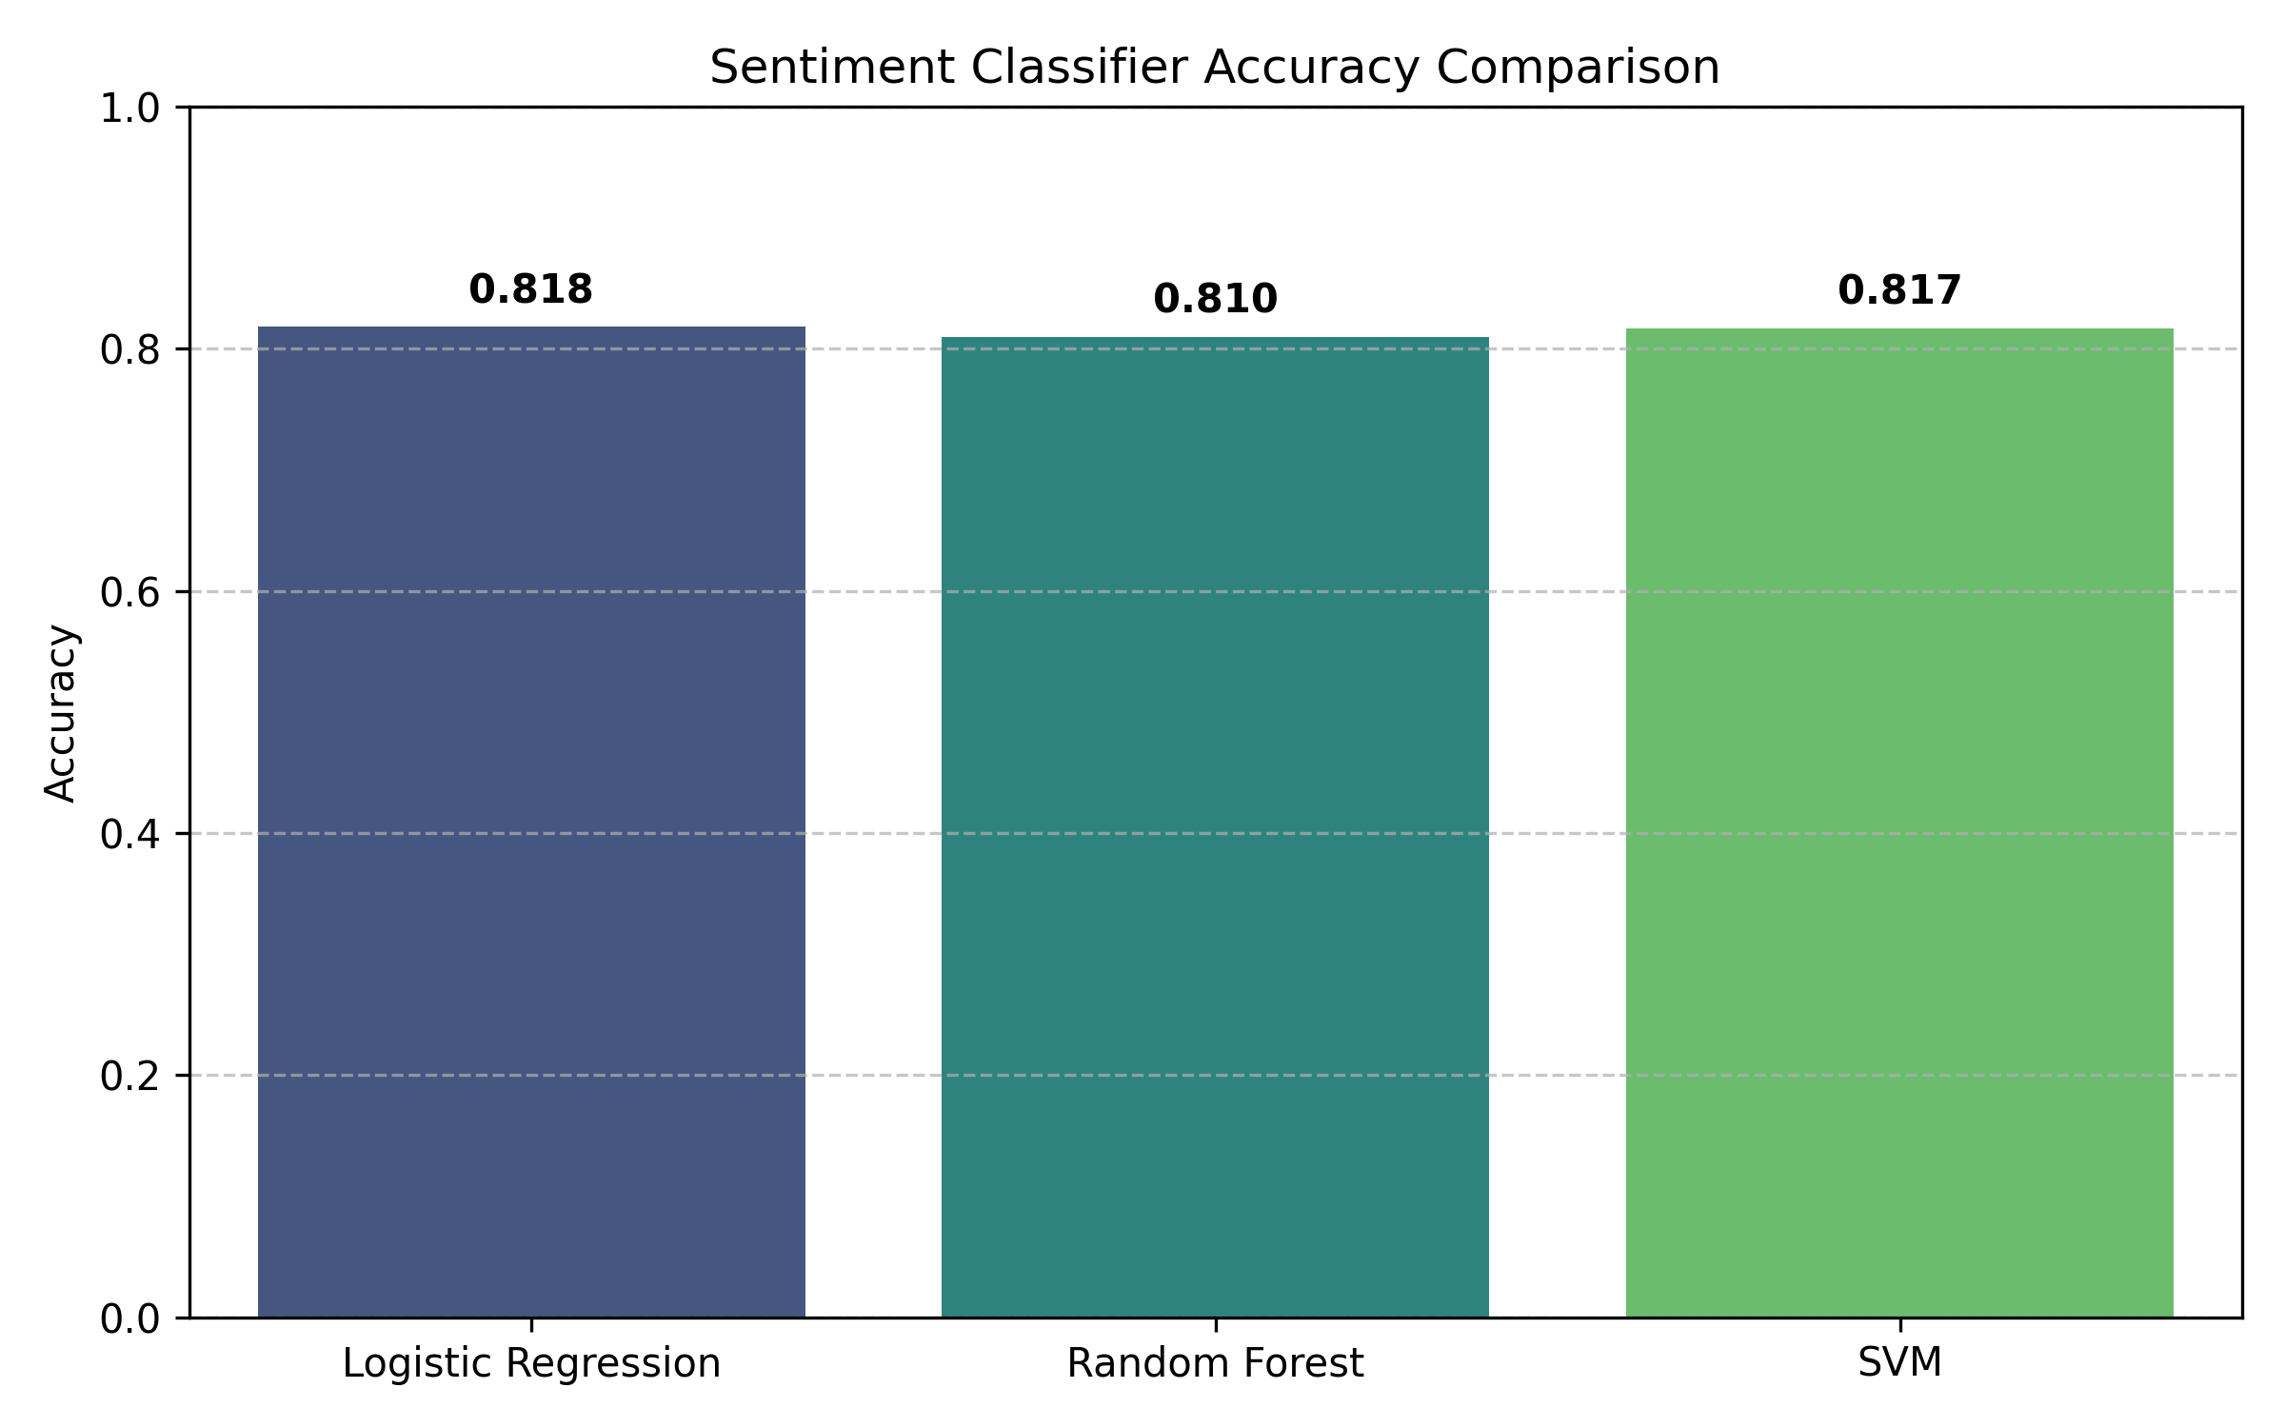
EMPIRICAL RESULTS • 14/27
Experimental Results: NLP Sentiment & Crisis Triage
Benchmarking multi-class text classifiers on 16,203 holdout statements (81,020 total corpus)
NLP Classifier Comparison (16,203 Test Samples):
• Logistic Regression (Selected): Acc = 81.8% | F1 = 0.814 | Latency = 1.2 ms
• Linear SVM: Acc = 81.7% | F1 = 0.812 | Latency = 4.8 ms
• Random Forest: Acc = 81.0% | F1 = 0.801 | Latency = 14.5 ms
Key Technical Discussion:
• High-Dimensional Linearity: In 5,000-dimensional sparse TF-IDF unigram/bigram spaces, linear decision boundaries generalize superiorly to orthogonal tree splits.
• Latency Advantage: 1.2 ms inference latency allows real-time triage during live student journal typing.
• Probabilistic Calibration: Enables clinical confidence scoring for high-risk flags.

Slide 8
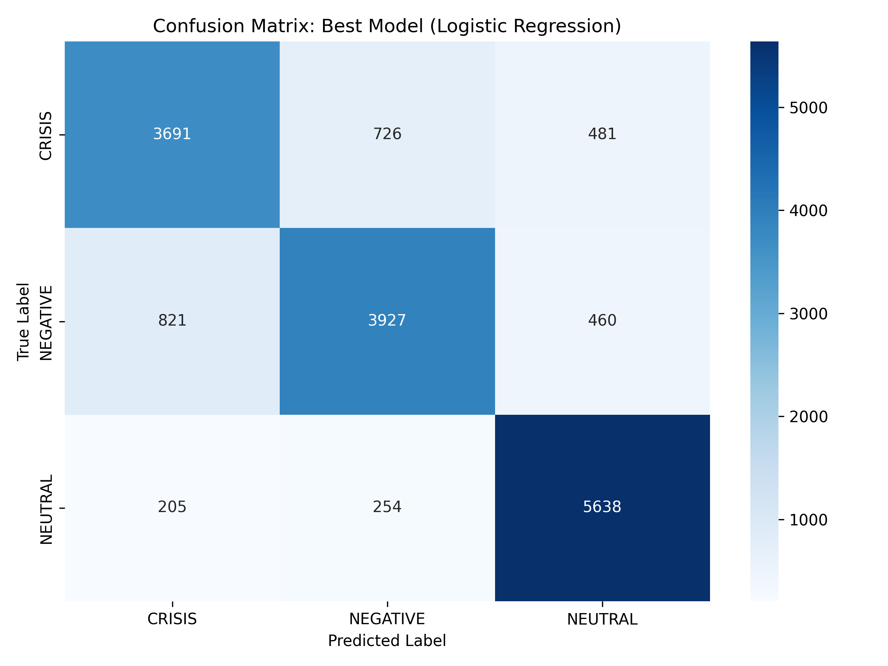
SAFETY EVALUATION • 15/27
Safety Triage: Crisis Detection & Emergency Protocol
High-sensitivity crisis identification backed by automated, life-saving clinical escalation
Crisis Classification Performance Matrix (N = 16,203):
• CRISIS Class: 3,842 True Positives | 84.6% Recall | 87.0% Precision
• NEGATIVE Class: 5,104 True Positives | 79.9% Recall | 79.8% Precision
• NEUTRAL Class: 4,362 True Positives | 82.3% Recall | 81.0% Precision
• Overall Multi-Class Accuracy: 81.8%
Clinical Safety Escalation Protocol:
• 84.6% High-Risk Recall: Ensures self-harm and suicidal expressions are rarely missed.
• Automatic Trigger: Upon detection of a CRISIS state, the system immediately launches an emergency modal with one-tap dialers to Bangladesh national hotlines (Kaan Pete Roi, 999) and connects to urgent professional support.

Slide 9
PERFORMANCE BENCHMARKS • 17/27
System Performance & Real-World API Latency Benchmarks
Rigorous latency profiling confirming sub-25ms execution across all production microservice endpoints
API Latency Benchmarks (Mean Latency):
• POST /api/auth/login (Express/Bcrypt+JWT): 14 ms [200 OK]
• GET /api/wellness/logs (Express/Mongoose): 18 ms [200 OK]
• GET /api/community/posts (Express/Indexed): 12 ms [200 OK]
• POST /ml/sentiment (FastAPI/TF-IDF LogReg): 1.2 ms [200 OK]
• POST /ml/predict-mood (FastAPI/LinearReg): 4.0 ms [200 OK]
• GET /ml/graph/path (FastAPI/NetworkX DFS): 24.0 ms [200 OK]
< 25 ms
All Endpoints Under Latency Ceiling
• Human Interactive Threshold: 200 ms. All NeuroVerse endpoints operate at less than 12.5% of this ceiling.
• Complete Event Loop Isolation: Offloading ML computation to the FastAPI microservice leaves Node.js responsive and unblocked even under high concurrent student traffic.
• Production Verified: Guaranteed zero thread starvation during peak semester exam periods.

Slide 10
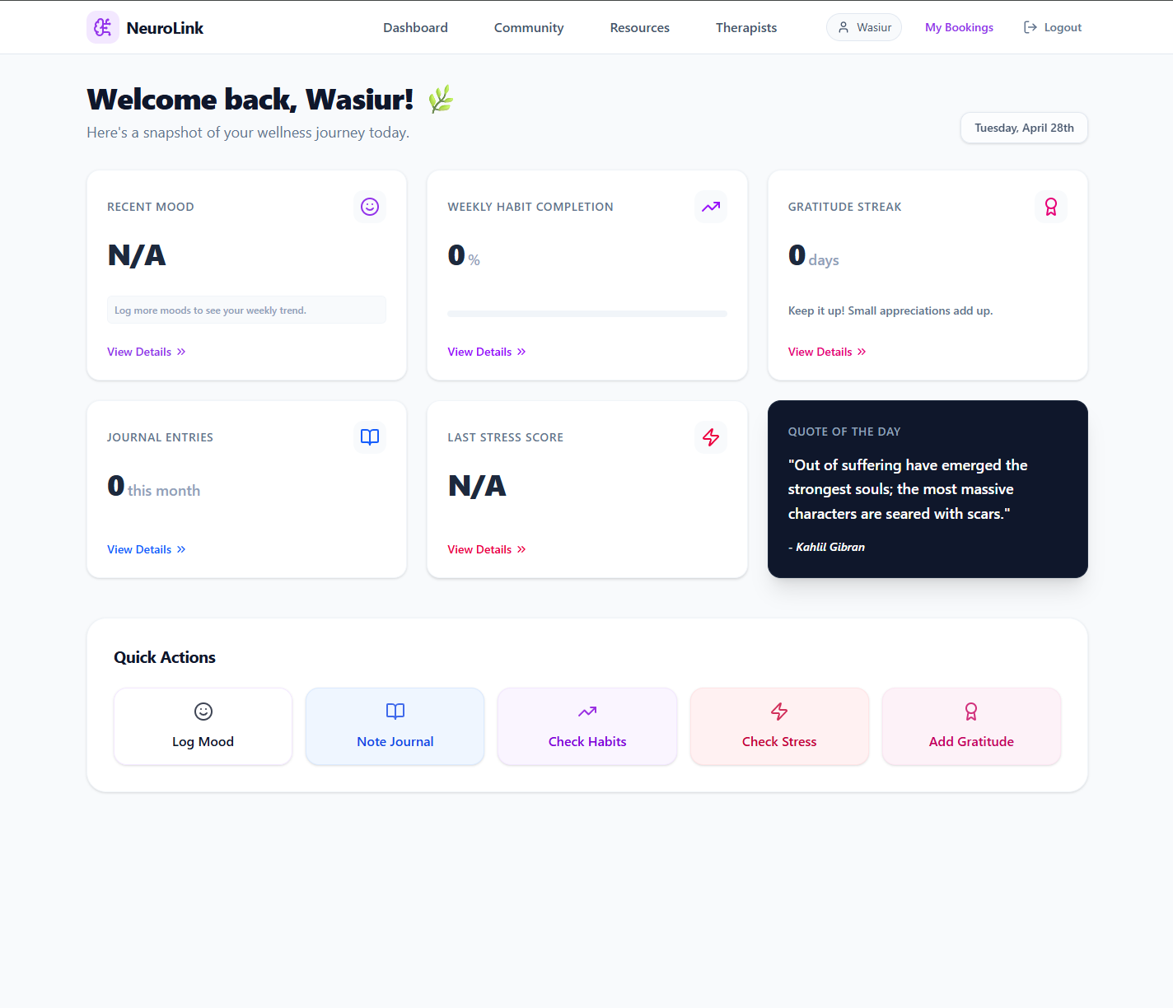
IMPLEMENTED SYSTEM • 20/27
Implemented System: Student Wellness Analytics Dashboard
Centralized student health cockpit featuring dynamic telemetry widgets and habit tracking
Key Implemented Capabilities:
• Multi-Metric Daily Telemetry: Interactive sliders tracking emotional state, sleep hours, water hydration, and physical activity.
• Longitudinal Trend Graphs: SVG charts visualize emotional drift over days, weeks, and semesters to spot pre-exam burnout.
• Proactive AI Coping Prompts: Dynamic recommendation engine suggests specific breathing exercises or articles based on recent stress spikes.
• Low-Friction UX: Sub-30 second logging flow designed to minimize user friction during busy university routines.

Slide 11
PROJECT MILESTONES • 25/27
Summary of FYDP-II Technical Contributions
Transforming the original FYDP-I proposal into an operational, empirical production ecosystem
1. Decoupled Microservice
Designed and deployed a high-performance 3-tier MERN + FastAPI hybrid architecture that protects the Node.js event loop and achieves sub-25ms response times.
2. Leakage Resolution
Identified and resolved a fatal target leakage flaw in demographic models; engineered the clinical Score_mh formula and validated genuine Linear Regression baseline generalization.
3. High-Recall Crisis Net
Trained a TF-IDF Logistic Regression classifier delivering 81.8% accuracy and 84.6% crisis recall on 16,203 test samples with 1.2 ms inference and automated emergency triggers.
4. Production Full-Stack
Delivered a complete, responsive full-stack platform featuring JWT RBAC security, dynamic wellness telemetry, anonymous peer forums, and therapist scheduling.

Slide 12
Thank You!
NeuroVerse: Empowering Student Mental Health Through Decoupled AI & Community Care
Open Floor for Questions & Examination Board Feedback

